Slide 1
SMOOBOARD
Lab Study

Slide 2
Agenda
Goals
Participants
Environment
Results
Key Findings
Possible changes for our A/B testing

Slide 3
Goals
1. Users should be able to complete tasks without guidance from a test facilitator
2. Users should find the application useful to obtain more information about the CCA
3. Users should find it easy to navigate through the app and obtain more information
4. Users should be able to complete tasks within the time frame given
5. Users should find features in the application useful
6. Users should find the design of the application pleasing

Slide 4
Tasks
Task 1 A: Navigate the application by using the search / filter function
Task 1 B: Navigate through the application and find the Eye Investment Page without using the search / filter function
Task 2: Explore the page to find out more about page and upcoming events offered by Eye Investment
Task 3: Sign up to be a member of Eye Investment

Slide 5
Tasks
Task 4: Send Eye Investment an inquiry message
Task 5: Add an Eye Investment Research Meeting to Calendar from Eye Investment Page
Task 6: Navigate to your Calendar (Assuming successfully registered as Eye Investment
Task 7: Schedule a project meeting with your Eye Investment Group Member

Slide 6
Participants
3 participants:
- One Year 2 student from SIS
- One Year 2 student from SOA
- One Year 1 Student from SIS
All meet pre-test requirement:
-age between 18 to 25
-use social media platforms or the school emailing system to find information about the school at least once every 2 to 3 days.

Slide 7
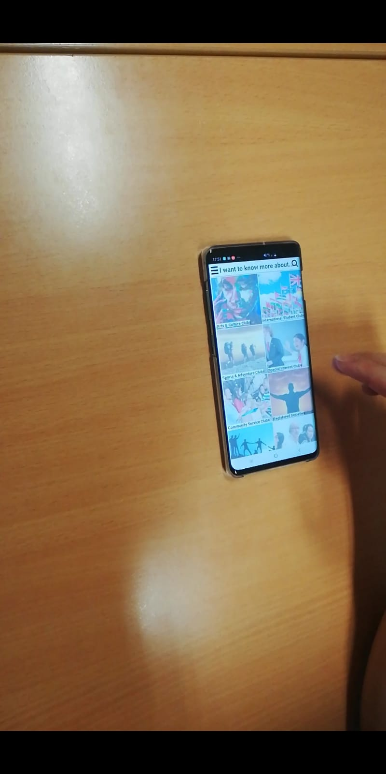
Environment
The lab study is done in a GSR
The participants were made to use the
mobile phones to test the app

Slide 8
Results
Goals | Results
1. Users should be able to complete tasks without guidance from a test facilitator | Goal partially reached. Think aloud data and critical incidents revealed that some participants did not understand and navigated into completely different pages.
2. Users should find the application useful to obtain more information about the CCA | Goal reached. Average rating from participants is 7.3
3. Users should find it easy to navigate through the app and obtain more information | Goal failed. Participants navigated into different pages at times due to lack of understanding of the application structure. On average, 4 clicks were made, 1 more than our target

Slide 9
Results
Goals | Results
4. Users should be able to complete tasks within the time frame given | Goal failed. The users exceeded the total target time by an average of 46 seconds. Identified the 2 tasks responsible for the delay.
5. Users should find features in the application useful | Mixed reviews. Some said some pages were intuitive while others said that the same page was not intuitive.
6. Users should find the design of the application pleasing | Goal reached. Average rating from participants is 7

Slide 10
Key Findings
1. There was a lot of confusion over the filter button as the filter system is not dynamic.
2. A lot of people did not know if they reached the bottom of a page and scrolled more times than necessary.
3. Users were confused on where to add a meeting event from Eye Investment onto the calendar. They assumed that this could be done on the calendar.
4. Many people are used to the Google Calendar UI, so they often try to create a new event by tapping on the calendar instead of hitting a button with a prompt on it.
5. There were many cases where the user could not find a button even if it was right next to what the user was looking at.

Slide 11
Key Findings
6. Many people do not like the Grid button UI system. Many buttons are not intuitive as well.
7. Users forgot the name of the application because a logo is only found on the login page.
8. Fonts, shapes and colors thought to be dull and boring.
9. Some people did not find some buttons intuitive enough and it took time for the user to find them.
10. User had trouble differentiating between a checkbox and radio button. Confused by the lack of a prompt to "tick one" or "choose a few"
11. Some users tried to explore pages that were not available.

Slide 12
Possible changes for A/B testing
1. Improve the interaction logic to make it more dynamic to users for A/B testing
2. Have an indicator to show that you have reached the bottom of the page. IOS or Android indicators are a good example.
3. Have the user read the Eye Investment page by making it more appealing by adjusting the flow of information. Also ensure that the user is given ample time to read the page.
4. Change the interaction of the Calendar function to be more like the Google UI system such that a tap on the screen will give a prompt to have a new event.

Slide 13
Possible changes for A/B testing
5. Change the color scheme, font type, font size and font color to make certain features more eye catching
6. Change the way information is displayed for a more aesthetic, less click requiring UI system.
7. Change the instructions to be more specific, especially for checkboxes and radio buttons on forms ("Tick one" or "Tick multiple" for example)

